Slide 1
Welcome
CS 472/572
Unsupervised Machine Learning
PCA Analysis
Week-9 -Class -2
Spring 2026
Instructor: Dr. Khondker Fariha Hossain

Slide 2

Topics
Eigenvectors and eigenvalues
Variance and multivariate Gaussian distributions
Computing a covariance matrix from data
Principal Components Analysis (PCA)

Slide 3
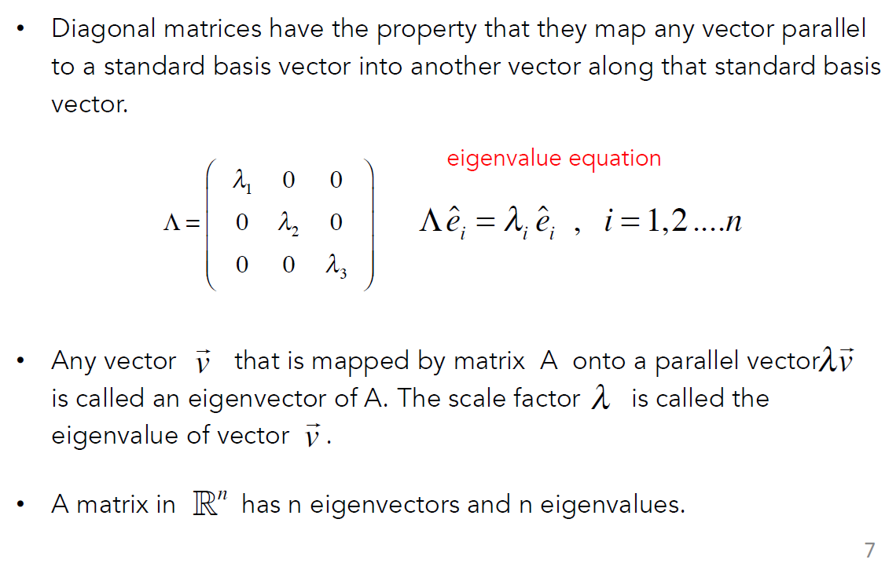

From Last Class Eigenvectors and eigenvalues

Slide 4
Variance
Variance is the sum of squares of differences between all numbers and means.
Variance (σ²) = (Sum of the squared differences from the mean) / (Total number of values)
In mathematical notation: σ² = Σ(x - μ)² / (n)
Here:
- μ is the mean of independent features
-Mean (μ) = (Sum of all values) / (Total number of values)

Slide 5
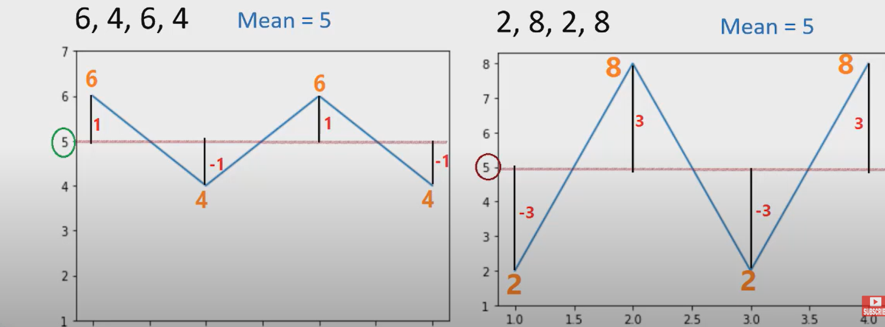
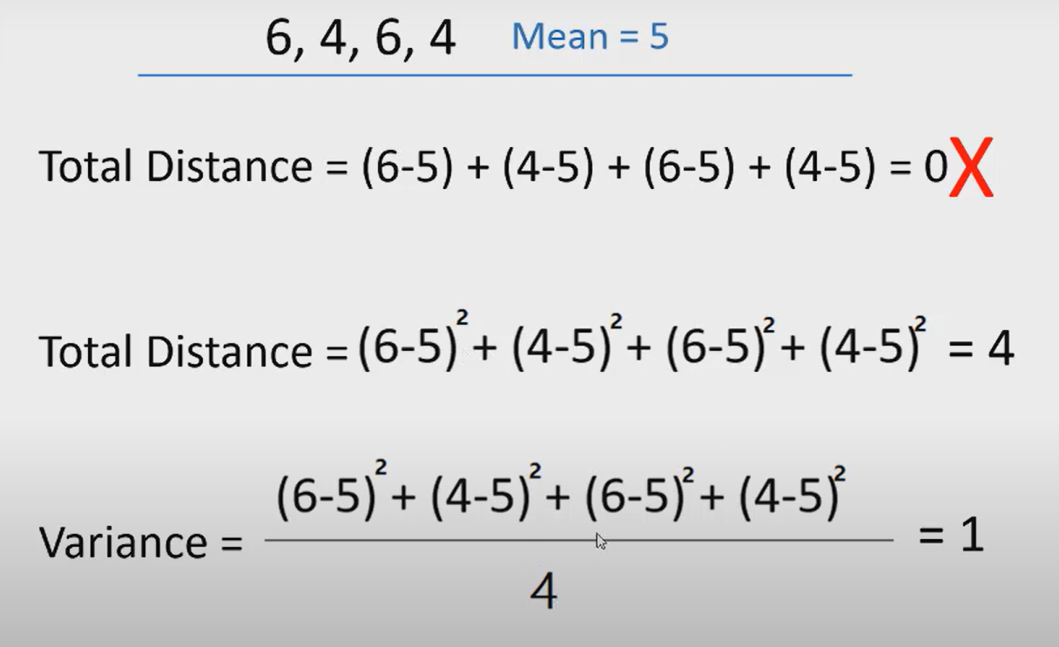
Varience
The variance is a measure that indicates how much data scatter around the mean
In mathematical notation: σ² = Σ(x - μ)² / (n)
.

Slide 6
Covariance
It is the relationship between a pair of random variables where change in one variable causes change in another variable.
It can take any value between -infinity to +infinity, where the negative value represents the negative relationship whereas a positive value represents the positive relationship.
It is used for the linear relationship between variables.
It gives the direction of relationship between variables.

Slide 7

Covariance
The formula for the covariance (Cov) between two random variables X and Y, each with N data points, is as follows:
Where:
Cov(X,Y) is the covariance between X and Y.
N is the number of data points.
Xi and Yi represent individual data points for X and Y, respectively.

Slide 8
Step 1: Obtain the Data
Collect and organise the raw dataset into a matrix of m observations × n variables
Data Matrix X
Matrix Layout
Arrange the data as a matrix X:
• Each row = one observation (sample)
• Each column = one variable (feature)
Dimensions: X is m × n
where m = number of observations
and n = number of variables
Var 1
Var 2
...
Var n
Obs 1
xᵢⱼ
xᵢⱼ
xᵢⱼ
Obs 2
xᵢⱼ
xᵢⱼ
xᵢⱼ
...
xᵢⱼ
xᵢⱼ
xᵢⱼ
Obs m
xᵢⱼ
xᵢⱼ
xᵢⱼ
X → m rows (observations) × n cols (variables)
All variables must be numerical. Ensure data is complete before proceeding.

Slide 9
Step 2: Subtract the Mean
Centre the data by subtracting the mean of each variable from all its values
Why Centre the Data?
Formula
PCA finds directions of maximum variance.
If data is not centred, the covariance matrix measures variance around zero, not around the data's true centre.
Centring ensures we measure relative spread correctly.
μⱼ = (1/m) · Σᵢ xᵢⱼ
X̃ = X − μ (centred data matrix)
Effect:
Procedure
Before
Mean ≠ 0
After
Mean = 0
1. Compute mean μⱼ for each variable j
2. Subtract: x̃ᵢⱼ = xᵢⱼ − μⱼ for all i, j
→
After centring, mean of every variable in X̃ equals exactly zero

Slide 10
Step 3 : Calculate Covariance Matrix
Compute how every pair of variables varies together using the centred data
Covariance Formula
Covariance Matrix Structure
C = (1/(m−1)) · X̃ᵀ · X̃
Var(X₁)
Cov(X₁,X₂)
Cov(X₁,X₃)
where X̃ is the centred data matrix
Each entry Cᵢⱼ tells us:
• Cᵢᵢ = variance of variable i
• Cᵢⱼ = covariance of variables i and j
Result: C is an n × n symmetric matrix
Cov(X₂,X₁)
Var(X₂)
Cov(X₂,X₃)
Cov(X₃,X₁)
Cov(X₃,X₂)
Var(X₃)
= diagonal (variance terms)
= off-diagonal (covariance terms)
C is always symmetric: Cᵢⱼ = Cⱼᵢ • Diagonal entries are always non-negative

Slide 11
Step 4 :Eigenvalues & Eigenvectors of C
Solve the characteristic equation det(C − λI) = 0 to find eigenvalues, then eigenvectors
Eigenvalues λ
Key Properties
det(C − λI) = 0
Eigenvalue = Variance
1
λᵢ measures the variance of the data along eigenvector vᵢ. Larger λ = more important direction.
• Solve the characteristic equation
• Yields n eigenvalues: λ₁ ≥ λ₂ ≥ … ≥ λₙ
• Each λ = amount of variance in that direction
Eigenvectors are Orthogonal
2
All principal component directions are perpendicular to each other — vᵢᵀvⱼ = 0 for i ≠ j.
Eigenvectors v
Unit Eigenvectors
(C − λᵢI) · vᵢ = 0 → solve for each vᵢ
3
Normalise each eigenvector so ‖vᵢ‖ = 1. These become the principal component axes.
Sort eigenvalues in descending order: λ₁ ≥ λ₂ ≥ … ≥ λₙ (most to least important)

Slide 12
Step 5: Choose Principal Components
Select the top k eigenvectors that capture sufficient variance for your application
How to Choose k
Eigenvalue Ranking
A
Variance Threshold
PC 1
Keep enough PCs to explain 95% (or 90%/80%) of total variance
PC 2
B
Scree Plot Elbow
PC 3
λ₃
Plot eigenvalues vs PC number. Pick k at the 'elbow' where curve flattens
PC 4
λ₄
C
Fixed Dimension
▲ KEEP
▼ DROP
Set k to a target dimension (e.g. k=2 for 2D visualisation)
PC 5
λ₅ (smallest)
Explained Variance Ratio = λₖ / Σλᵢ
The top k eigenvectors form the projection matrix W of size n × k

Slide 13
Step 6 : Derive the New Dataset
Project the centred data onto the selected principal components to get the reduced representation
Projection Formula
Dimension Reduction Flow
Y = X̃ · W
X̃
× W
= Y
X̃ = centred data matrix (m × n)
W = projection matrix (n × k)
Y = new reduced dataset (m × k)
m × n
(original dims)
n × k
(top-k eigenvectors)
m × k
(reduced dataset)
Benefits:
What It Means
• Variables in Y are uncorrelated (orthogonal)
• Storage: m·k instead of m·n values
• k << n means massive dimension reduction
Each row of Y is one observation expressed in the new PC coordinate system.
Y has k columns — one per chosen principal component — and m rows (same as original data)

Slide 14
Step 7 : Analyse & Interpret Results
Examine the principal components and evaluate how well the reduced data represents the original
A
Examine PC Loadings
B
Variance Explained
Each eigenvector component (loading) tells you how strongly each original variable contributes to that PC. Large loading = strong influence.
Compute the proportion of variance each PC captures: λᵢ / Σλ. Plot the scree plot to visualise the distribution.
C
Visualise Reduced Data
D
Reconstruction & Error
Plot Y on the first 2 or 3 PCs for visualisation. Clusters in PC space reveal underlying structure in the data.
Reconstruct: X̂ = Y·Wᵀ + μ. Compute reconstruction error ‖X̃ − Y·Wᵀ‖² to measure information lost.
The goal: determine whether k PCs faithfully represent the original n-dimensional data

Slide 15
PCA Algorithm: As a whole
1
2
3
4
Obtain Data
→
Subtract Mean
→
Covariance Matrix
→
Eigendecomposition
Arrange data as m × n matrix X
X̃ = X − μ (centre each variable)
C = (1/(m−1)) · X̃ᵀX̃
Solve det(C − λI) = 0, find vᵢ
↓
5
6
7
Select k PCs
→
Project Data
→
Analyse Results
Choose top k by variance explained
Y = X̃ · W (new dataset m × k)
Loadings, variance %, reconstruction

Slide 16
Let’s ……………..
Solve a Numerical Example

Slide 17
Problem Definition
Objective: Reduce dimensions from 2D to 1D using PCA on a 4-sample dataset
Feature
Example 1
Example 2
Example 3
Example 4
X₁
4
8
13
7
X₂
11
4
5
14
2
4
1
6
Features
Samples
Target Dims
Steps
X₁ and X₂
Examples
After PCA
In this example

Slide 18
Step 1 : Calculate Mean
Compute the mean of each feature across all 4 samples
Formula
Calculation
μ = (1/n) · Σ xᵢ
where n = number of samples
and xᵢ = individual values
Mean of X₂ = (11 + 4 + 5 + 14) / 4 = 34 / 4
μ₂ = 8.5
Mean of X₁ = (4 + 8 + 13 + 7) / 4 = 32 / 4
Result Summary
μ₁ = 8
Mean vector: μ = [ 8, 8.5 ]

Slide 19
Step 2 : Covariance Matrix
Measure how the two features vary together using centered data
Covariance Formula
Covariance Matrix C
X₁
X₂
Var(X₁) = Σ(x₁ᵢ − μ₁)² / (n−1)
Var(X₂) = Σ(x₂ᵢ − μ₂)² / (n−1)
Cov(X₁,X₂) = Σ(x₁ᵢ−μ₁)(x₂ᵢ−μ₂) / (n−1)
X₁
38
−38
−38
38
Computed Values
X₂
Var(X₁) = 114/3 = 38
Var(X₂) = 114/3 = 38
Cov(X₁,X₂) = −114/3 = −38
Negative covariance → X₁ and X₂ move in opposite directions

Slide 20
Step 3: Eigenvalues of Covariance Matrix
Solve det(C − λI) = 0 to find the eigenvalues
Characteristic Equation
Eigenvalue Results
|C − λI| = 0
|38−λ −38 |
|−38 38−λ | = 0
λ₁ = 76
LARGER eigenvalue — first principal component
λ₂ = 0
Solving
(38−λ)² − (38)² = 0
λ² − 76λ + 1444 − 1444 = 0
λ(λ − 76) = 0
Smaller eigenvalue — second principal component
λ₁ = 76 captures ALL the variance → we only need 1 principal component!

Slide 21
Step 4: Compute Eigenvectors
Solve (C − λ₁I)v = 0 for the eigenvector corresponding to λ₁ = 76
System of Equations (λ₁ = 76)
Normalizing the Eigenvector
(38−76)v₁ + (−38)v₂ = 0
−38v₁ − 38v₂ = 0
−38v₁ = 38v₂
v₁ = −v₂
Length of X₁:
‖X₁‖ = √(1² + (−1)²)
‖X₁‖ = √2 ≈ 1.4142
Unit eigenvector e₁:
e₁ = X₁ / ‖X₁‖ = [1/√2, −1/√2]
Taking t = 1: X₁ = [1, −1] (un-normalized)
e₁ = [0.707, −0.707]
e₂ = [0.707, 0.707]
← PC1 (use this)
← PC2 (λ₂=0, drop)

Slide 22
Step 5: First Principal Components
Projection Formula
All Projected Values
y = e₁ᵀ · xₖ
= 0.707·x₁ₖ + (−0.707)·x₂ₖ
= 0.707·(x₁ₖ − x₂ₖ)
Sample
X₁
X₂
PC₁
1
4
11
−4.305
Example: Sample 1 (x₁=4, x₂=11)
2
8
4
3.536
y₁ = 0.707×4 + (−0.707)×11
= 2.828 − 7.777
= −4.305
3
13
5
5.657
4
7
14
−5.091
2D data successfully reduced to 1D!

Slide 23
Step 6 : Geometric Meaning
Project data onto e₁ axis — each point's coordinate on e₁ IS its PC₁ value
1
Original 2D Data
2
Shift to Center
Four points scattered in the X₁–X₂ plane. Each needs 2 numbers to describe it.
Move the origin to the mean point [8, 8.5]. Axes now pass through the data center.
3
Rotate to e₁
4
Drop Perpendiculars
Align the new axis with eigenvector e₁. The e₁-axis captures the maximum variance.
Project each point onto the e₁-axis. Each projection is one 1D coordinate.
1D result: { −4.305, 3.536, 5.657, −5.091 } — each a single number on the e₁-axis

Slide 24
Summary
1
Calculate Mean
2
Covariance Matrix
3
Eigenvalues
μ₁=8, μ₂=8.5
C = [[38,−38],[−38,38]]
λ₁=76, λ₂=0
4
Eigenvectors
5
Project onto PC₁
6
1D Result
e₁=[0.707,−0.707]
y = e₁ᵀ · xₖ
{−4.31, 3.54, 5.66, −5.09}
PCA transforms correlated high-dimensional data into uncorrelated lower dimensional components.

Slide 25
Inclass Activity - Colab
https://colab.research.google.com/drive/1F1SvTg7lrD6sLwmZ3vpyTN443MwHdxqd?usp=sharing

Slide 26
Thank You
Reference:
MIT- 940 Introduction to Neural Computation
https://vtupulse.com/machine-learning/principal-component-analysis-in-machine-learning/

